Slide 1
Using adjunctive web/mobile ACT technologies to augment clinical practice
Michael E. Levin, Jacqueline Pistorello,
Steven C. Hayes, John Seeley, Crissa Levin, Kristy Dalrymple, Brandon Gaudiano &
Jack Haeger

Slide 2
Disclosure
The ACT on College Life project is supported by a Small Business Innovation Research grant awarded to Contextual Change LLC
National Center for Complementary and Alternative Medicine - R43 AT006952
The ACT-CL project is intended to eventually lead to a commercial program

Slide 3
Some Potential Questions for improving practice with ACT
How do we increase the reach of ACT outside of face-to-face therapy?
How do we enhance the efficacy and efficiency of ACT?
How do we support clinicians who are learning ACT?

Slide 4
Benefits of Adjunctive Technologies
How do we increase the reach of ACT outside of face-to-face therapy?
Self-guided interventions accessible outside of therapy
And includes supportive accountability from provider
How do we enhance the efficacy and efficiency of ACT?
Efficiency: Reducing number/frequency of in-person therapy sessions
Efficacy: Greater treatment dosage, supporting skills generalization
How do we support clinicians who are learning ACT?
Core content provided through technology-based intervention
Integrated training in ACT through adjunctive technology

Slide 5
Overview of Adjunctive technologies being developed
ACT on College Life: Guided self-help website for college counseling centers
Valued Living: Self-guided website for patients receiving medication management
ACT Toolbox: Mobile app to augment ACT therapy

Slide 6
ACT on College Life
Guided self-help program for college counselors to use with student clients
Prototype developed for Phase I grant awarded to Contextual Change LLC (PIs: Pistorello and Levin)
Counselor portal
Training system
Monitoring system
Student portal
Self-help sessions (3 currently developed)
Session 1: Values clarification
Session 2: Acceptance
Session 3: Mindfulness

Slide 11
Pilot trial overview
Pre-post open trial examining feasibility and potential efficacy of the prototype program
Multi-site study
4 participating college counseling centers
30 counselors and 82 student clients
Student clients presented with a range of problems, but excluded if not clinically stable

Slide 12
Procedures
30 Counselors recruited at site
82 Students recruited by their counselor
Baseline Assessment: Knowledge Test
Baseline Assessment:
Depression, anxiety and stress (DASS)
Satisfaction with life (SWLS)
Psychological inflexibility (AAQ-II)
Mindfulness (FFMQ)
Values (PVQ-Education)
Knowledge Test
10 Week Program Period
Training
Certification test (> 80%)
Recruit students
4 Week Program Period
Post Assessment:
Completed by n = 20, 67%
Knowledge Test
Usability/Satisfaction
Phone Interview
Post Assessment:
Completed by n = 36, 44%
Same as baseline
Plus program usability/satisfaction

Slide 13
program usage/Satisfaction
Counselor program usage
80% (n = 24) completed the training
Used program with average of 3.42 clients (SD = 2.34, Range = 0–9)
Significant improvement in ACT-CL knowledge from pre to post, t(19) = -3.69, p = .002, Cohen’s d = .42
Client program completion rates
67% completed session 1
38% completed all three sessions
System Usability Scale
Counselors, M = 83.25, SD = 11.50 (“Good” to “Excellent” range)
Students, M = 86.53, SD = 12.43 (within the “Excellent” range)

Slide 14
Client pre to post changes
Outcome Measures | Paired t-test | Cohen’s d
Depression | 3.63** | .55
Anxiety | 2.63* | .44
Stress | 3.75** | .66
Satisfaction with Life | 4.07*** | .39
Process Measures | Paired t-test | Cohen’s d
Psychological Inflex. | 4.03*** | .61
Observing | 3.04** | .38
Act with Awareness | 3.24** | .40
Nonjudgmental | 4.72*** | .70
Education Success | 3.33** | .52
Education Reasons | 2.19* | .36
ACT Knowledge | 4.65*** | .88

Slide 15
Client pre to post changes
Outcome Measures | Paired t-test | Cohen’s d
Depression | 3.63** | .55
Anxiety | 2.63* | .44
Stress | 3.75** | .66
Satisfaction with Life | 4.07*** | .39
Process Measures | Paired t-test | Cohen’s d
Psychological Inflex. | 4.03*** | .61
Observing | 3.04** | .38
Act with Awareness | 3.24** | .40
Nonjudgmental | 4.72*** | .70
Education Success | 3.33** | .52
Education Reasons | 2.19* | .36
ACT Knowledge | 4.65*** | .88
Reductions in AAQ-II were related to all post outcomes (controlling for baseline)
Partial correlation coefficients ranging from .44 to .55

Slide 16
Summary of findings
ACT-CL appears to be feasible and acceptable with both counselors and their clients
Need to further address student engagement
Plans to develop the full ACT-CL program and test it in a RCT in a Phase II grant

Slide 17
Valued living program
Self-guided adjunctive website for depressed/anxious clients receiving only medication management
Address barriers to seeking therapy such as time, cost, and availability
Collaboration with Drs. Dalrymple and Gaudiano at Alpert Medical School of Brown University
Developed as a prototype through Qualtrics survey platform
Four, 45-minute sessions targeting values and committed action

Slide 18
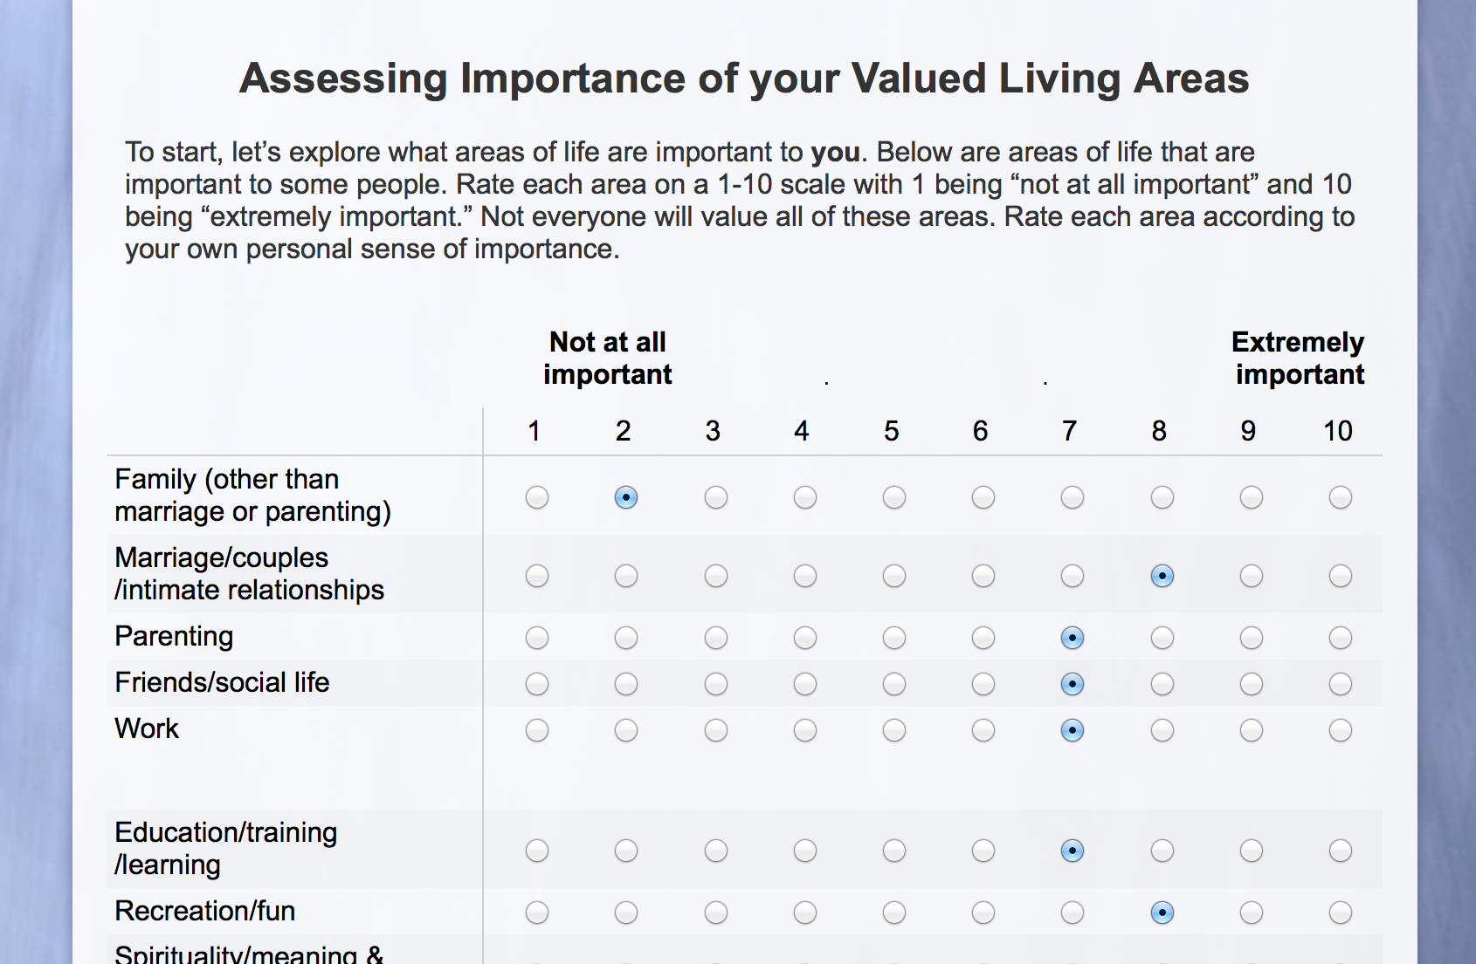

Slide 19
Future research
Initial open trial with depressed/anxious patients receiving medication management
Starting this month at Rhode Island Hospital
Waitlist RCT planned as the next step depending on initial results
Testing adjunctive self-guided interventions in partial hospital, inpatient, primary care and after care service

Slide 20
The ACT Toolbox: Mobile App to Augment ACT Treatment
Can a mobile app augment learning and applying ACT skills learned in therapy?
Providing regular monitoring and “just in time” interventions
Assess psychological factors throughout the day
Provide tailored skill coaching menu based on responses
Access brief skill coaching sessions
Funded through Utah State University Research Catalyst grant
Developing the program starting next month with InterVision Media
Testing Spring 2015 with 20 depressed and anxious clients receiving ACT

Slide 21
Discussion
Research is needed on how adjunctive technologies can be used to leverage training, efficiency, efficacy and reach of ACT
Technologies may vary from
Integrating “guided” interventions into face-to-face therapy
To providing self-guided interventions for those not receiving therapy
To providing mobile apps to support what is being learned in therapy
Among many other opportunities
Importance of maintaining a focus on theory with research on these technologies
Testing theory with large, well controlled dismantling and clinical component tests
Examining processes of change

Slide 22
Thank you!
Collaborators:
Steven C. Hayes, Ph.D.
University of Nevada, Reno & Contextual Change
Jacqueline Pistorello, Ph.D.
University of Nevada, Reno & Contextual Change
John Seeley, Ph.D.
Oregon Research Institute
Crissa Levin, M.A.
University of Nevada, Reno & Contextual Change
Kristy Dalrymple, Ph.D.
Alpert Medical School of Brown University & Rhode Island Hospital
Brandon Gaudiano, Ph.D.
Alpert Medical School of Brown University
Jack Haeger,
Utah State University

